Slide 1


SAP UI5 & FIORI with OData TRAINING
Anubhav Oberoy & Nishan Nainsukha
Day – 4

Slide 2

Agenda – Day 4
Variables in JavaScript
Datatypes in JavaScript
JavaScript Object Notation (JSON)
What JS can do
Ways to display output in JS
Function with parameters
Functions with multiple parameters
Validation
Debugger in JS
Adding Dynamic Element in JS using HTML
Synchronous and Asynchronous Response

Slide 3
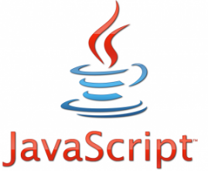
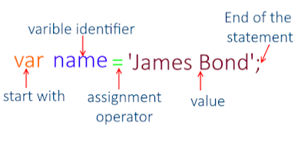
Variables in JS
Variables are containers for storing data (values).
All JavaScript variables must be identified with unique names
These unique names are called identifiers.
JavaScript identifiers are case-sensitive.
We use var keyword to create variables, use const keyword to create constants
Types of variables
var
let
Scalar (single value)
Array (group of similar data types)
Objects
Java Script Object Notation - JSON

Slide 4
Datatypes in JS
Data types describe the different types or kinds of data that we're gonna be working with and storing in variables. In Javascript, there are five basic, or primitive, types of data. The five most basic types of data are strings, numbers, Booleans, undefined, and null. We refer to these as primitive data types.
01
Boolean
Boolean represents a logical entity and can have two values: true and false.
Data Types
02
Null
The null type has exactly one value: null.
03
String
JavaScript's String type is used to represent textual data.
04
Number
Numbers can be written with or without decimals.
05
Undefined
Undefined variable that has not been assigned a value has the value undefined.

Slide 5

Exercise
In this exercise we will cover all the variable types and data types.
Exercise Code:
Console.txt

Slide 6


JavaScript Object Notation (JSON)
JavaScript Object Notation (JSON) is a standard text-based format for representing structured data based on JavaScript object syntax.
The JSON format is syntactically similar to the code for creating JavaScript objects.
It’s a light weight data format for communication over http services.
JavaScript has a built in function for converting JSON strings into JavaScript objects: JSON.parse().
JavaScript also has a built in function for converting an object into a JSON string: JSON.stringify()
How to validate JSON = https://www.jsonlint.com
Example of JSON:
var oEmp = { "empId": 5000,
"empName": "Anubhav", "salary" : 8500, "curr": "USD" };
Exercise code links for JSON
JSON.txt

Slide 7
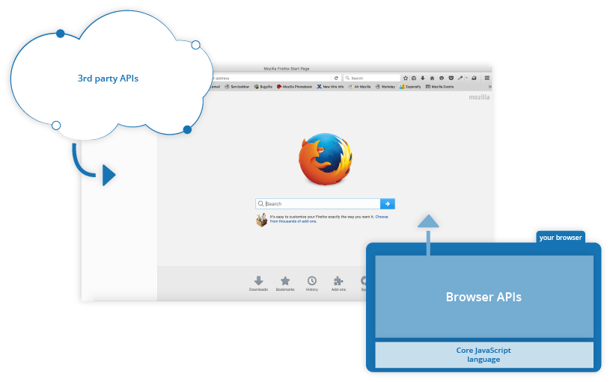
What JS Can do ?
JavaScript is one of the world's most popular programming languages, primarily used to add automation, animations and interactivity to Web pages.
The DOM (Document Object Model) API allows you to manipulate HTML and CSS, creating, removing and changing HTML, dynamically applying new styles to your page, etc.
The Geolocation API retrieves geographical information. This is how Google Maps is able to find your location and plot it on a map.
In this we can apply Validation using if , else if, else.
Putting dynamic text into HTML page using JavaScript.

Slide 8
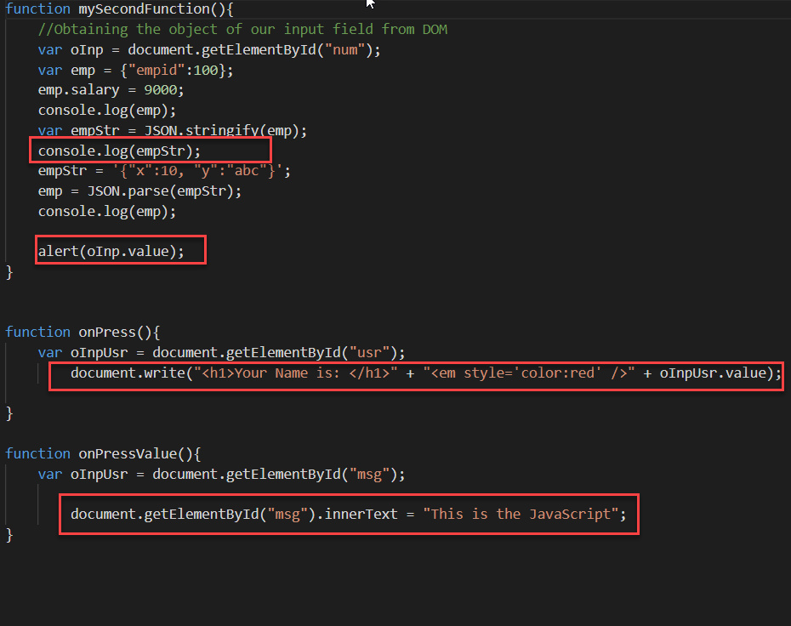
Ways to Display Output in JS
There are 4 types of Output Functions in JS:
window.alert
document.write
Console.log()
HTMLElement.innerText
document – the object of DOM. With the help of this we can get access to all/single HTML elements which are displayed to the user on the screen. So we can perform dynamic code.
getElementById – used to provide object of a single HTML element
getElementsByClassName – used to provide object of array which is a collection elements having same class name
getElementsByTagName - used to provide object of array which is a collection elements having same tagName
window – it is the object of our browser web page. The window object is used to expose methods like open, alert, quit.
Exercise code links of all Output Functions
reuse.js
Index.html

Slide 9

Functions with parameters
Function parameters are the names listed in the function definition.
Function arguments are the real values passed to (and received by) the function.
Parameter Rules
JavaScript function definitions do not specify data types for parameters.
JavaScript functions do not perform type checking on the passed arguments.
JavaScript functions do not check the number of arguments received.
Parameters:
Name: It is used to specify the name of the function.
Arguments: It is provided in the argument field of the function.
Function with single parameter
function(number) {
return number * number
}

Slide 10
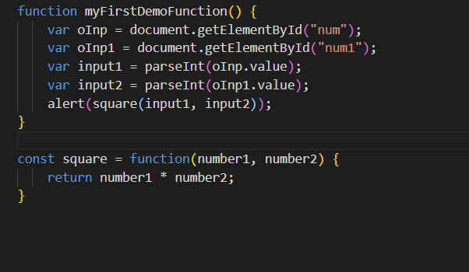
Functions with multiple parameters
A JavaScript function does not perform any checking on parameter values (arguments).
Function parameters are the names listed in the function definition.
If a function is called with missing arguments (less than declared), the missing values are set to undefined.
Syntax of function with multiple parameters
function functionName(parameter1, parameter2, parameter3) { // code to be executed }
Exercise code links for Multiple parameter
index.html
reuse.js

Slide 11
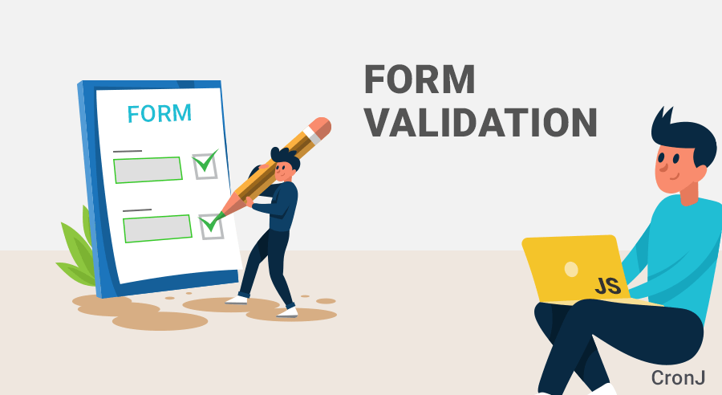
Validations in JavaScript
Data validation is the process of ensuring that user input is clean, correct, and useful.
Most often, the purpose of data validation is to ensure correct user input.
In JavaScript, we can validate name, password, email, date, mobile numbers and more fields.
In JS the “=” is operator is assignment operator and “==” is comparison operator.
“===” is a strict equal, which compare value and datatype.
Exercise code links of all Output Functions
reuse.js
Index.html

Slide 12
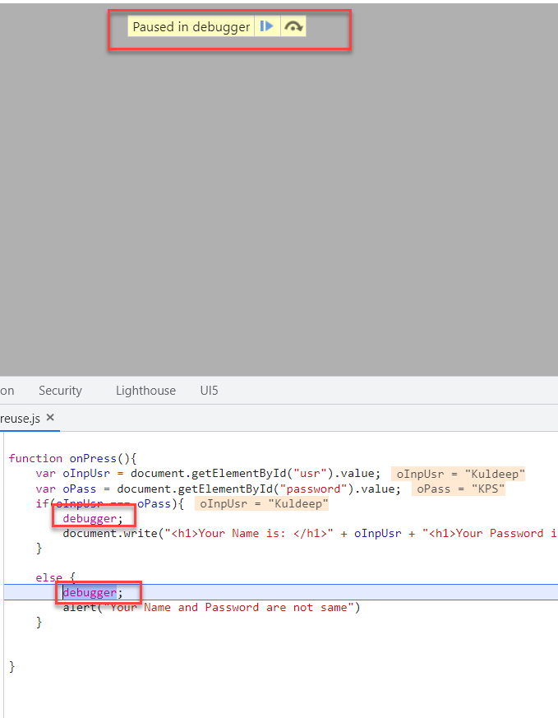
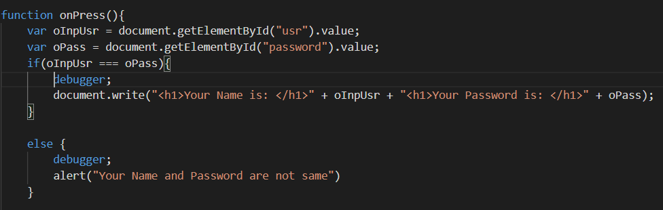
Debugger in JS
The debugger statement stops the execution of JavaScript, and calls (if available) the debugging function.
Using the debugger statement has the same function as setting a breakpoint in the code.
Normally, you activate debugging in your browser with the F12 key, and select "Console" in the debugger menu.
If no debugging is available, the debugger statement has no effect.
Exercise code links of all Output Functions
reuse.js
Index.html

Slide 13
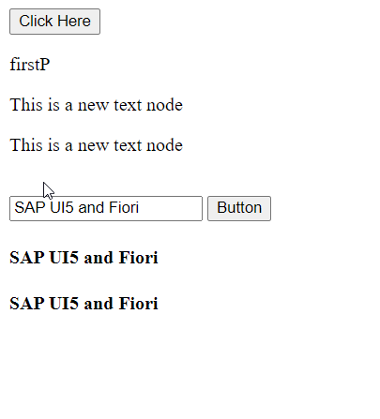
Adding Dynamic Element
HTML documents can be easily accessed and manipulated using HTML DOM , which represents an HTML document as a tree-structure. When an HTML document is loaded in a browser window, it becomes a Document object.
With document.createElement() method you can create a specified HTML element dynamically in JavaScript.
document.createElement is used with an HTML tag to create the element. The textContent is then modified and then the class attribute is modified using setAttribute .
Exercise code links of all Output Functions
reuse.js
Index.html

Slide 14
Synchronous and Asynchronous Response
User
Screen
Server
Database
Save
Processing
Time
Request send to server
Request to Database
Synchronous Response
For all this time user
Remains blocked
Response form Database
Save
Request send to server
For all this time user
Remains blocked
Request to Database
Asynchronous Response
For all this time user
Is Not Blocked
Response from the server
Response form Database

Slide 15
Exercise
In this exercise we will create two button 1. Async Button, 2.Sync Button .
Exercise Code:
Index.html
reuse.js

Slide 16

End of Day 4

Slide 17

Questions

Slide 18

Anubhav Oberoy

Slide 19


We’re committed to empower you to be
Most Desirable Resource
through powerful training solutions.
We build the workforce of the future.
250+
Corporate Clients
30,000+
Learners Trained
25000+
Learners Placed
FREE WEBINARS
Sign up for free webinars with industry experts every fortnight!
Enroll Now!
Contact us today!
https://anubhavtrainings.com/

Slide 20




More from AnubhavTrainings.com

